Slide 1
Micro Inversions Final Presentation
Joshan Bajaj, Oneeb Malik, Dan Smillie, John Wilson
Adapted from original Computational Genomics Final Presentation for Parallel Final Project

Slide 2
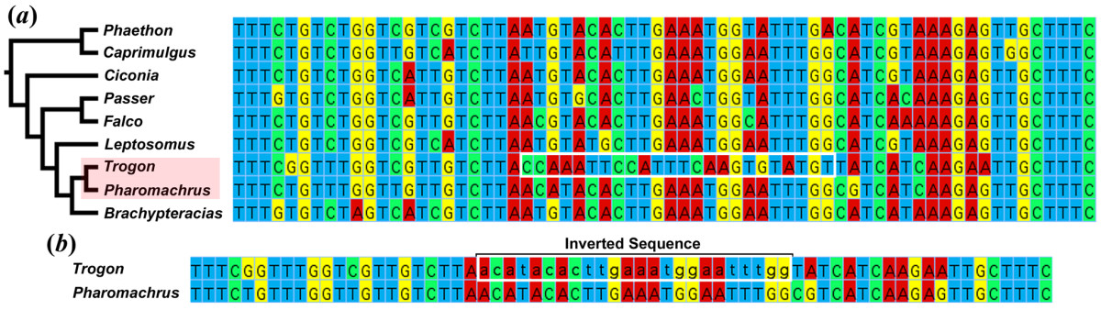
Background
Micro inversions: 15bp-100bp reverse complementary mutations
More difficult to detect and not as well understood as other structural variants
Useful for phylogenetic classification and identifying disease causes
Example inverted sequence in avian phylogenetic tree
Notes:
The exact definition of micro inversions varies slightly depending research goals, but they are generally accepted to be reverse complementary mutations that span 15 to 100 base pairs. They are more difficult to detect than single nucleotide polymorphisms, so naturally they are not as well studied as other structural variants.
However, they are thought to play a role in differentiating phylogenetically similar species and causing homoplastic mutations in humans, which can cause disease. In this image, we can see a 15 base pair micro inversion present in intron 6 of the TPM1 region of two closely related avian species.

Slide 3
Simulation Generators
Sequence generator
Creates a randomly generated sequence of nucleotides of a given length
Adds unclassified nucleotides with a given probability
Read generator
Global variables that determine read length, number of reads, and inversion size range
Generates non-overlapping reads with randomly generated micro inversions
Keeps track of the indices of reads and inversions for verification
Notes:
Because our algorithm was initially designed to handle micro inversions but not other structural variants, and because of the sparsity of micro inversion truth data available, we decided to simulate our own sequences and reads to develop our detection method. First we wrote a simple program to randomly generate a nucleotide sequence of a given length with occasional unclassified nucleotides.
From that generated sequence, we sampled non-overlapping 100 base pair reads and then simulated micro inversions in those reads of a random length within a given range. The simulator also kept track of the position of the reads in the sequence and the position of the inversions in the reads for validation purposes.

Slide 4
Algorithm -- Preprocessing
-Iterate through chunks of genetic sequence
-Count nucleotide and N density
-Add to dictionary, using density as key and maps to locations
-Store dictionary and sequence string as pickle file
-Time complexity is O(G)

Slide 5
Algorithm -- Find Inversions
-Checks every possible inversion of a given length
-To generate a possible inversion, string is transformed to have part of it contain a reverse complement
-While the new string is being created, the character density is calculated
-With the character density calculated for the new string, the dictionary is checked for all k-mers with the same density to see if they are equivalent
-Time is O(nir^2) average case, but O(niGr^2) worst case
n = num reads i = max inversion length r = read length G = size of genome

Slide 6
AT-CG Coupling Method
-Keys for dictionary are numAT and numGC instead of all four nucleotides
-Useful since the character density for every read will always remain the same no matter what inversion length
-Works very well if the entire sequence is small (less than 2000), otherwise performs very slowly because each density has many locations to check
-Would have taken 14 days to run 2000 reads on a sequence that is 50mil nucleotides long

Slide 7
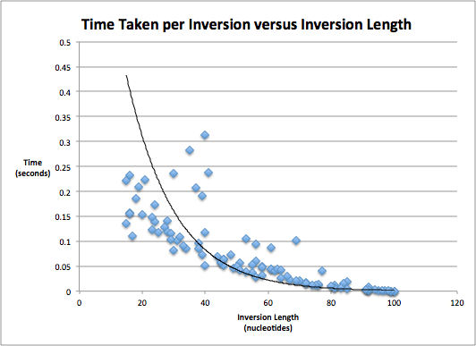
Results
100 Reads, 100k nucleotide sequence

Slide 8
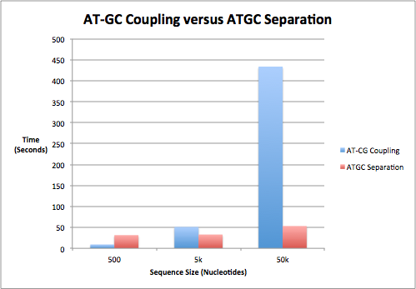

Slide 9
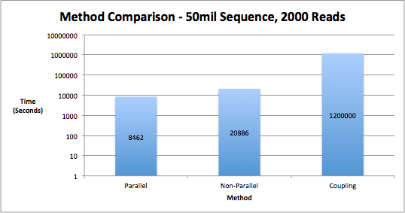

Slide 10
Looking Forward
- Parallelization would speed up the code the most
- Accuracy more important than speed
- Testing on actual reads requires alignment
- Speedup would be helpful, but not necessary in practice
- Would not have many reads that require the micro inversion checking

